Slide 1
Presented By
Ganesh.S

Slide 2
Learning:
Basic Essentials:
Java Essentials:
Java Fundamentals
File handling
String Handling
Generics and Collections

Slide 3
J2EE Essentials
Introduction to Web Application
Servlets and Jsp application.

Slide 4
SQL
Basic Queries
Creation of a Database
Creation of a Table
Insert Operation
Update Operation
Delete Operation

Slide 5
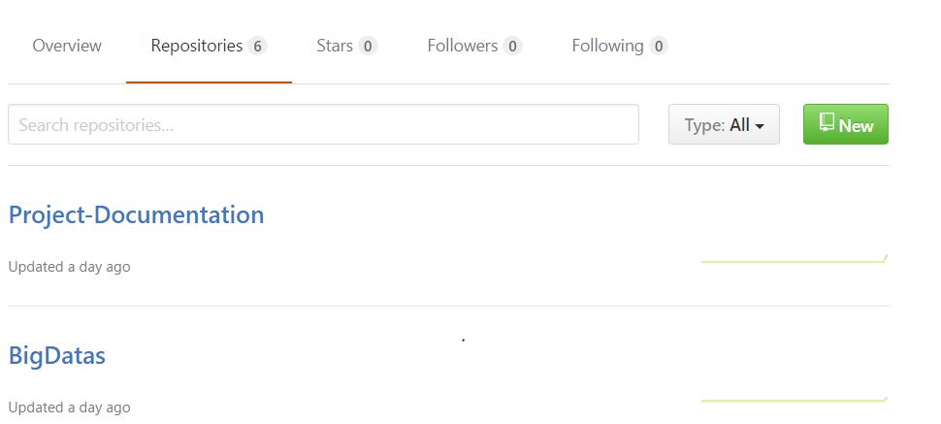
Github Link:
This is my github link for big data:
https://github.com/ganeshniitmyp/

Slide 6
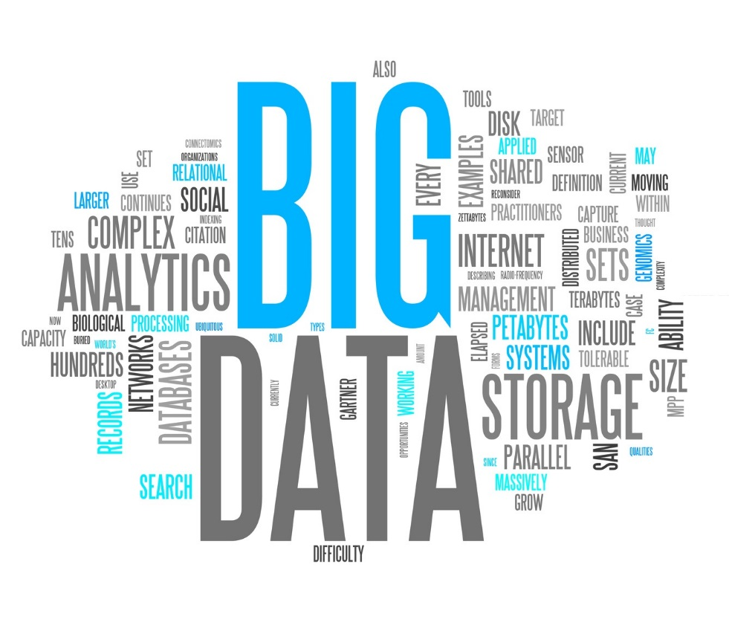

Slide 7
Big Data
Big data extremely large data sets that may be analysed computationally to reveal patterns, trends, and associations, especially relating to human behaviour and interactions.
Big data are analysis on 4 v’s:
volume : Used to handle the huge amount of data.
veracity: Used to fetch and analysis the data with accuracy
variety: Used to handle the structured,unstructured and semistructured data
velocity : Used to fetch and analysis the data very fast.

Slide 8


Slide 9
Hadoop & Features of Hadoop
Hadoop is an open source, Java-based programming framework that supports the processing and storage of extremely large data sets in a distributed computing environment.
Created by Doug Cutting and Mike Carafella in 2005.
Features of Hadoop:
Low cost
Scalability
Fault Tolerance
Efficient

Slide 10
















Who Uses Hadoop?

Slide 11
Data Analysis on Shopping
Objective:
The project is based on Data Analysis for Shopping.
This project would help in Analyzing for Maximum Business Profit, Customer Satisfaction, launching a new product in the shop.

Slide 12
Use Case
Use Case 1:To give the hats off points to the customer
Shopper analysis all transaction of amount greater than 160 based upon that shopper give the hats off points to the customers.
We are analyze the transaction range between 175 and 200 amount based upon that we are giving 20 percent discount of that product.

Slide 13
Use Case:
Use Case 2: To increase the profit of the shop
Based upon the total count and total transaction we are identify the customer needs of the product .Based upon that we have to include the products in the shop.
We are decrease the count of the non-sell products and also increase the profit of the shop.

Slide 14
Use Case:
Use Case 3: To give the discount for the products to the customer
In this case we are finding the customer who has spent maximum amount in the shop.
We have to give the discount by 25 percent of the product and it helps to improve the reference of the customer as well.

Slide 15
Use Case :
Use Case 4: Star of the Month
We are given the coupons worth amount of rupees 2000 to the customers.
We are announce that particular customer is the star of the month in our shop.

Slide 16
CONCLUSION:
The conclusion for this project is to increase profit as well as customer satisfaction of the shop.

Slide 17
CENSUS DATA ANALYSIS BY GOVERNMENT DEPARTMENT
Objective:
This project analysis for various departments are education, finance, social, planning, miscellaneous.

Slide 18
Use case:
Use Case 1: Government Jobs
All government Jobs vacancies filed by the recruitment process like written examination, interview, group discussion and physical tests (if necessary).
To apply for these vacancies, candidates should eligible for the posts as per eligibility criteria stipulated by that department like qualification, age limit and other eligibility conditions.
For example: Nominate the government job who are all the eligible persons based on education to collect the data from the total count of male and female candidate ,total count of employed /unemployed persons and total count for people in age range of 18-25 based on education.

Slide 19
Use Case :
Use Case 2: Growth of the country
The former British Prime Minister William Gladstone expressed the importance of finance for the economy in 1858 as follows: "Finance is, as it were, the stomach of the country, from which all the other organs take their tone."
For Example: We are analyze the growth of the country based on the total tax analysis ,gender wise and Per Capita Income(PCI) analysis consolidated, gender wise and category wise. It is very helpful to increase the growth of the country.

Slide 20
Use case :
Use case 3: Government planning to increase the scholarship to the citizens.
Government benefits from one of these six federal programs: Social Security, Medicare, Medicaid, welfare (TANF), unemployment benefits, and food stamps (SNAP).
Here, We are analysis the data of how much amount dispensed in the pension for above 60 years old peoples and then analysis the total amount dispensed in the scholarship of citizens based upon the criteria of father only present people, mother only present peoples, neither parent present and parents are not in the universe.
Next to analysis the details about how many peoples are employed in female widow and divorced. Based upon these details we are sending the information to the government to increase the benefits of those citizens.

Slide 21
Use case :
Use Case 4: Government to check whether who all citizens of our country
In this use case to count the voters, the total count of the senior citizenship and who are all the immigrants count for the employed lot .To count the total number of male and female. It is very useful to generate list of voting list.

Slide 22
Use Case :
USE CASE 5: Tax Filer Status
To find the who are all non-us citizens (not born in US).To give the details to the government who all are non-us citizens to pay the tax.

Slide 23
Conclusion:
This project is used to increase the chances of government jobs to the citizens and also increases the benefits of employed female widow divorced peoples.

